Slide 1

실습
Gi Sook Jung, Ph.D
School of Computer Science and Engineering
College of IT Engineering, KNU

Slide 2
NDKCalculator
JNI with NDK

Slide 3
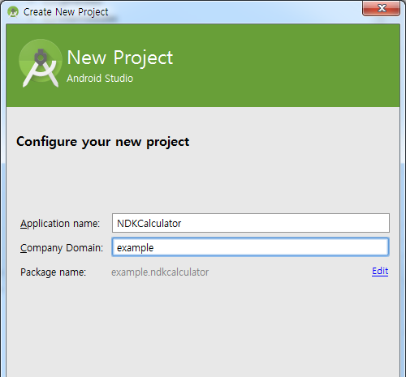
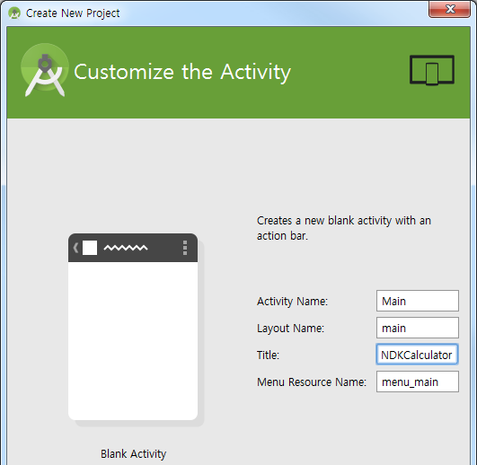
NDK calculator
주어진 Native Source와 layout으로 간단한 계산기를 만들어보자

Slide 4
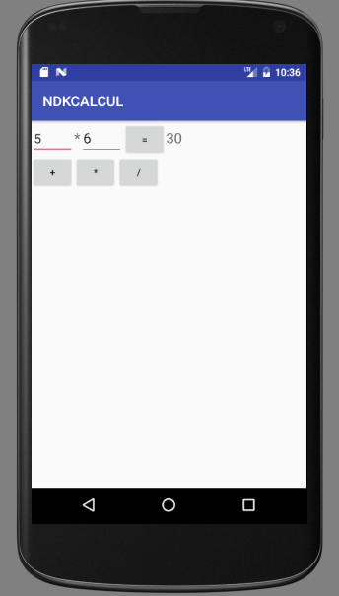
NDK calculator
NDKCalculator
/res/layout/main.xml
<?xml version="1.0" encoding="utf-8"?>
<LinearLayout
xmlns:android="http://schemas.android.com/apk/res/android"
android:layout_width=“match_parent"
android:layout_height="match_parent"
android:orientation="vertical" >
<LinearLayout
android:layout_width=“match_parent"
android:layout_height="wrap_content"
android:orientation="horizontal" >
<EditText
android:id="@+id/value1"
android:layout_width="60sp"
android:layout_height="wrap_content"
android:text="5" >
</EditText>
<TextView
android:id="@+id/display"
android:layout_width="wrap_content"
android:layout_height="wrap_content"
android:text="+"
android:textSize="20sp" >
</TextView>

Slide 5
NDK calculator
NDKCalculator
/res/layout/main.xml
<EditText
android:id="@+id/value2"
android:layout_width="60sp"
android:layout_height="wrap_content"
android:text="6"
android:textSize="20sp" >
</EditText>
<Button
android:id="@+id/btnCalc"
android:layout_width="60sp"
android:layout_height="wrap_content"
android:onClick="onClick"
android:text="=" >
</Button>
<TextView
android:id="@+id/Result"
android:layout_width="wrap_content"
android:layout_height="wrap_content"
android:layout_weight="0"
android:text="Result"
android:textSize="20sp" >
</TextView></LinearLayout>

Slide 6
NDK calculator
NDKCalculator
/res/layout/main.xml
<LinearLayout
android:layout_width="wrap_content"
android:layout_height="wrap_content"
android:orientation="horizontal" >
<Button
android:id="@+id/btn1"
android:layout_width="60sp"
android:layout_height="wrap_content"
android:onClick="onClick"
android:text="+" >
</Button>
<Button
android:id="@+id/btn2"
android:layout_width="60sp"
android:layout_height="wrap_content"
android:onClick="onClick"
android:text="*" >
</Button>
<Button
android:id="@+id/btn3"
android:layout_width="60sp"
android:layout_height="wrap_content"
android:onClick="onClick"
android:text="/" >
</Button>
</LinearLayout></LinearLayout>

Slide 7
NDK calculator
NDKCalculator
/src/Main.java
public class Main extends Activity {
static {
System.loadLibrary(“calculate”);
}
public native int add(int x, int y);
public native int mul(int x, int y);
public native int div(int x, int y);
TextView display;
String operator = "+";
@Override
public void onCreate(Bundle savedInstanceState) {
super.onCreate(savedInstanceState);
setContentView(R.layout.main);
display = (TextView) findViewById(R.id.display);
}

Slide 8
NDK calculator
NDKCalculator
/src/Main.java
public void onClick(View v) {
switch (v.getId()) {
case R.id.btn1:
operator = "+";
display.setText(operator);
break;
case R.id.btn2:
operator = "*";
display.setText(operator);
break;
case R.id.btn3:
operator = "/";
display.setText(operator);
break;
case R.id.btnCalc:
TextView result = (TextView) findViewById(R.id.Result);
EditText val1 = (EditText) findViewById(R.id.value1);
EditText val2 = (EditText) findViewById(R.id.value2);

Slide 9
NDK calculator
NDKCalculator
/src/Main.java
int v1, v2, res = -1;
try {
v1 = Integer.parseInt(val1.getText().toString());
v2 = Integer.parseInt(val2.getText().toString());
} catch (NumberFormatException e) {
v1 = 0; v2 = 0; }
if (operator.equals("+")) { res = add(v1, v2); }
else if (operator.equals("*")) { res = mul(v1, v2); }
else if (operator.equals("/")) { res = div(v1, v2); }
result.setText(new Integer(res).toString());
break;
}
}

Slide 10

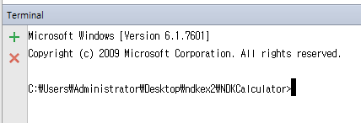
NDK calculator
Javah를 이용한 h파일 생성 및 c 소스파일로 변경
Alt+F12 로 Android Studio Terminal 실행(좌측하단버튼)
cd app/src/main/java 입력: 경로이동
Javah –d ../jni ex.ndkcalculator.Main 입력: h파일 생성
  패키지 이름과 클래스 이름을 반드시 확인할 것

Slide 11
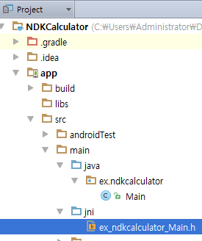
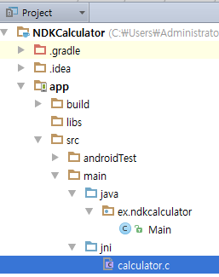
NDK calculator
JNI 폴더 내에 생성된 h파일을
calculator.c 로 변경 (Shift + F6)

Slide 12
NDK calculator
calculator.c 내용 변경
#include <jni.h>
#ifndef _Included_ex_ndkcalculator_Main
#define _Included_ex_ndkcalculator_Main
#ifdef __cplusplus
extern "C" {
#endif
jint Java_ex_ndkcalculator_Main_add(JNIEnv *env, jobject obj, jint value1, jint value2 ){
return (jint)(value1 + value2);
}
jint Java_ex_ndkcalculator_Main_mul(JNIEnv *env, jobject obj, jint value1, jint value2 ){
return (jint)(value1 * value2);
}
jint Java_ex_ndkcalculator_Main_div(JNIEnv *env, jobject obj, jint value1, jint value2 ){
return (jint)(value1 / value2);
}
#ifdef __cplusplus
}
#endif
#endif
Package
Activity
Function

Slide 13
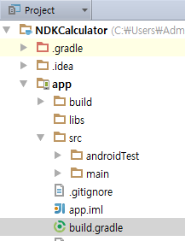
NDK calculator
Build.gradle (App)내용 변경
apply plugin: 'com.android.application'
android {
compileSdkVersion 23
buildToolsVersion "23.0.0"
defaultConfig {
applicationId "ex.ndk_calculator"
minSdkVersion 19
targetSdkVersion 23
versionCode 1
versionName "1.0"
}
buildTypes {
release {
minifyEnabled false
proguardFiles getDefaultProguardFile('proguard-android.txt'), 'proguard-rules.pro'
}
}
}
dependencies {
compile fileTree(dir: 'libs', include: ['*.jar'])
compile 'com.android.support:appcompat-v7:23.0.0'
}

Slide 14
NDK calculator
Build.gradle (App)내용 변경
compile 'com.android.support:appcompat-v7:23.0.0'
}
import org.apache.tools.ant.taskdefs.condition.Os
def getNdkBuildPath() {
Properties properties = new Properties()
properties.load(project.rootProject.file('local.properties').newDataInputStream())
def command = properties.getProperty('ndk.dir')
if (Os.isFamily(Os.FAMILY_WINDOWS)) {
command += "\\ndk-build.cmd"
} else {
command += "/ndk-build"
}
return command
}

Slide 15
NDK calculator
Build.gradle (App)내용 변경
return command
}
android {
sourceSets.main {
jniLibs.srcDir 'src/main/libs'
jni.srcDirs = []
}
ext {
nativeDebuggable = false
}
task buildNative(type: Exec, description: 'Compile JNI source via NDK') {
if (nativeDebuggable) {
commandLine getNdkBuildPath(), 'NDK_DEBUG=1', '-C', file('src/main').absolutePath
} else {
commandLine getNdkBuildPath(), '-C', file('src/main').absolutePath
}
}

Slide 16
NDK calculator
Build.gradle (App)내용 변경
commandLine getNdkBuildPath(), '-C', file('src/main').absolutePath
}
}
tasks.withType(JavaCompile) {
compileTask -> compileTask.dependsOn buildNative
}
task cleanNative(type: Exec, description: 'Clean native objs and lib') {
commandLine getNdkBuildPath(), '-C', file('src/main').absolutePath, 'clean'
}
clean.dependsOn 'cleanNative'
ext {
nativeDebuggable = true
}

Slide 17
NDK calculator
Build.gradle (App)내용 변경
ext {
nativeDebuggable = true
}
buildTypes {
debug {
jniDebuggable true
}
}
defaultConfig {
multiDexEnabled true
}
compileOptions {
sourceCompatibility JavaVersion.VERSION_1_7
targetCompatibility JavaVersion.VERSION_1_7
}
}

Slide 18
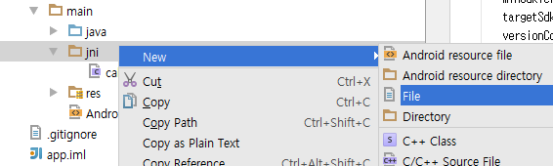
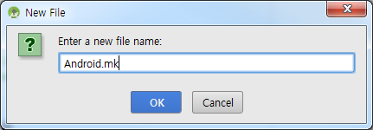
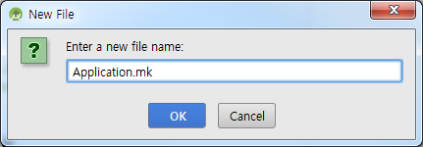
NDK calculator
JNI 폴더에 Android.mk / Application.mk 파일 생성

Slide 19
Android NDK
APP_ABI=all
NDKCalculator /jni/Android.mk
NDKCalculator /jni/Application.mk
LOCAL_PATH := $(call my-dir)
include $(CLEAR_VARS)
LOCAL_MODULE := calculate
LOCAL_SRC_FILES := calculator.c
LOCAL_LDLIBS := -llog
include $(BUILD_SHARED_LIBRARY)
APP_ABI=all

Slide 20
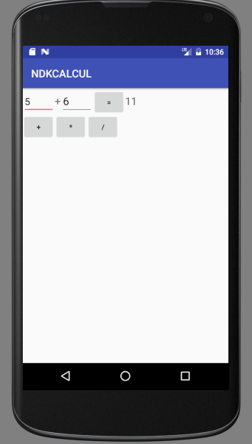
NDK calculator

Slide 21
NDKCalculator #2
JNI with NDK

Slide 22
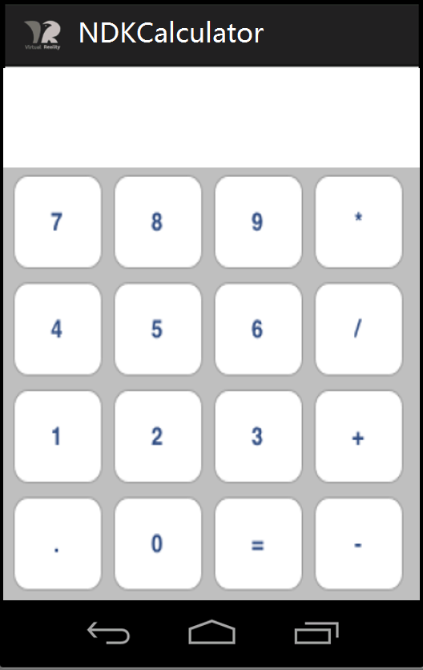
NDK Calculator#2
소수점 및 여러 자리 수 인식이
가능하도록 제작할 것
NDK 를 이용하여 사칙연산이
가능한 Calculator 완성
계산식과 결과는TextView에 출력

Slide 23
실습 후 주의사항
실습을 완료하고 Bitbucket에 Push
Bitbucket에 Push 완료하면
반드시 자리에서 프로젝트 파일 및 캡쳐화면 삭제
에뮬레이터 내의 애플리케이션도 삭제
파일이 남아 있을 경우 감점

Slide 24
제출
제출형식
  주어진 문제의 기능을 보여주는 화면을 캡쳐한 보고서 작성
  소스파일과 보고서를 Bitbucket에 제출
주의
  마감 : 다음 수업 전날 자정(만점)
  이후 제출은 채점대상에서 제외함

Slide 25


